Slide 1
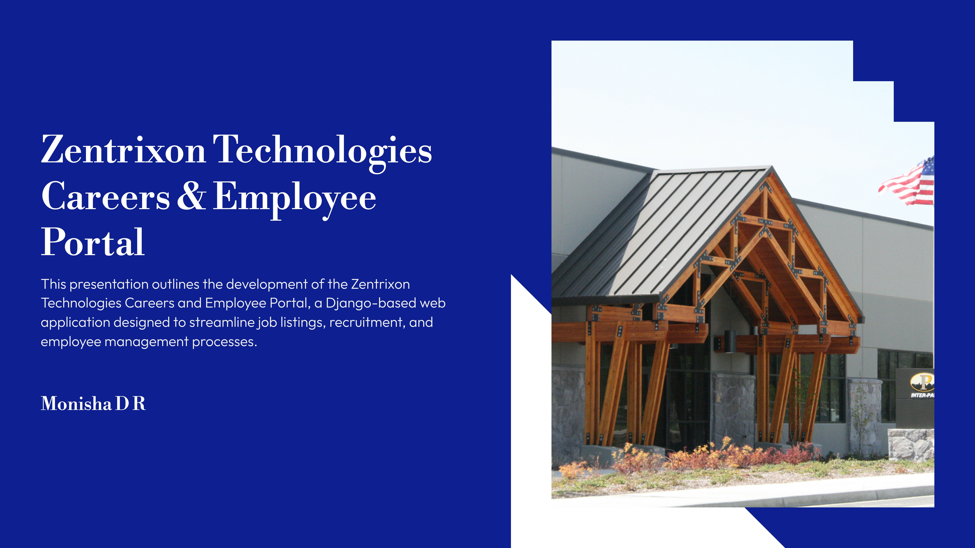
Submitted by
Chinmayi K S
Jyothsna Shivanya K S
M J Reethu
Monisha D R
Varshini M R
Guided by
Bramesh S M

Slide 2
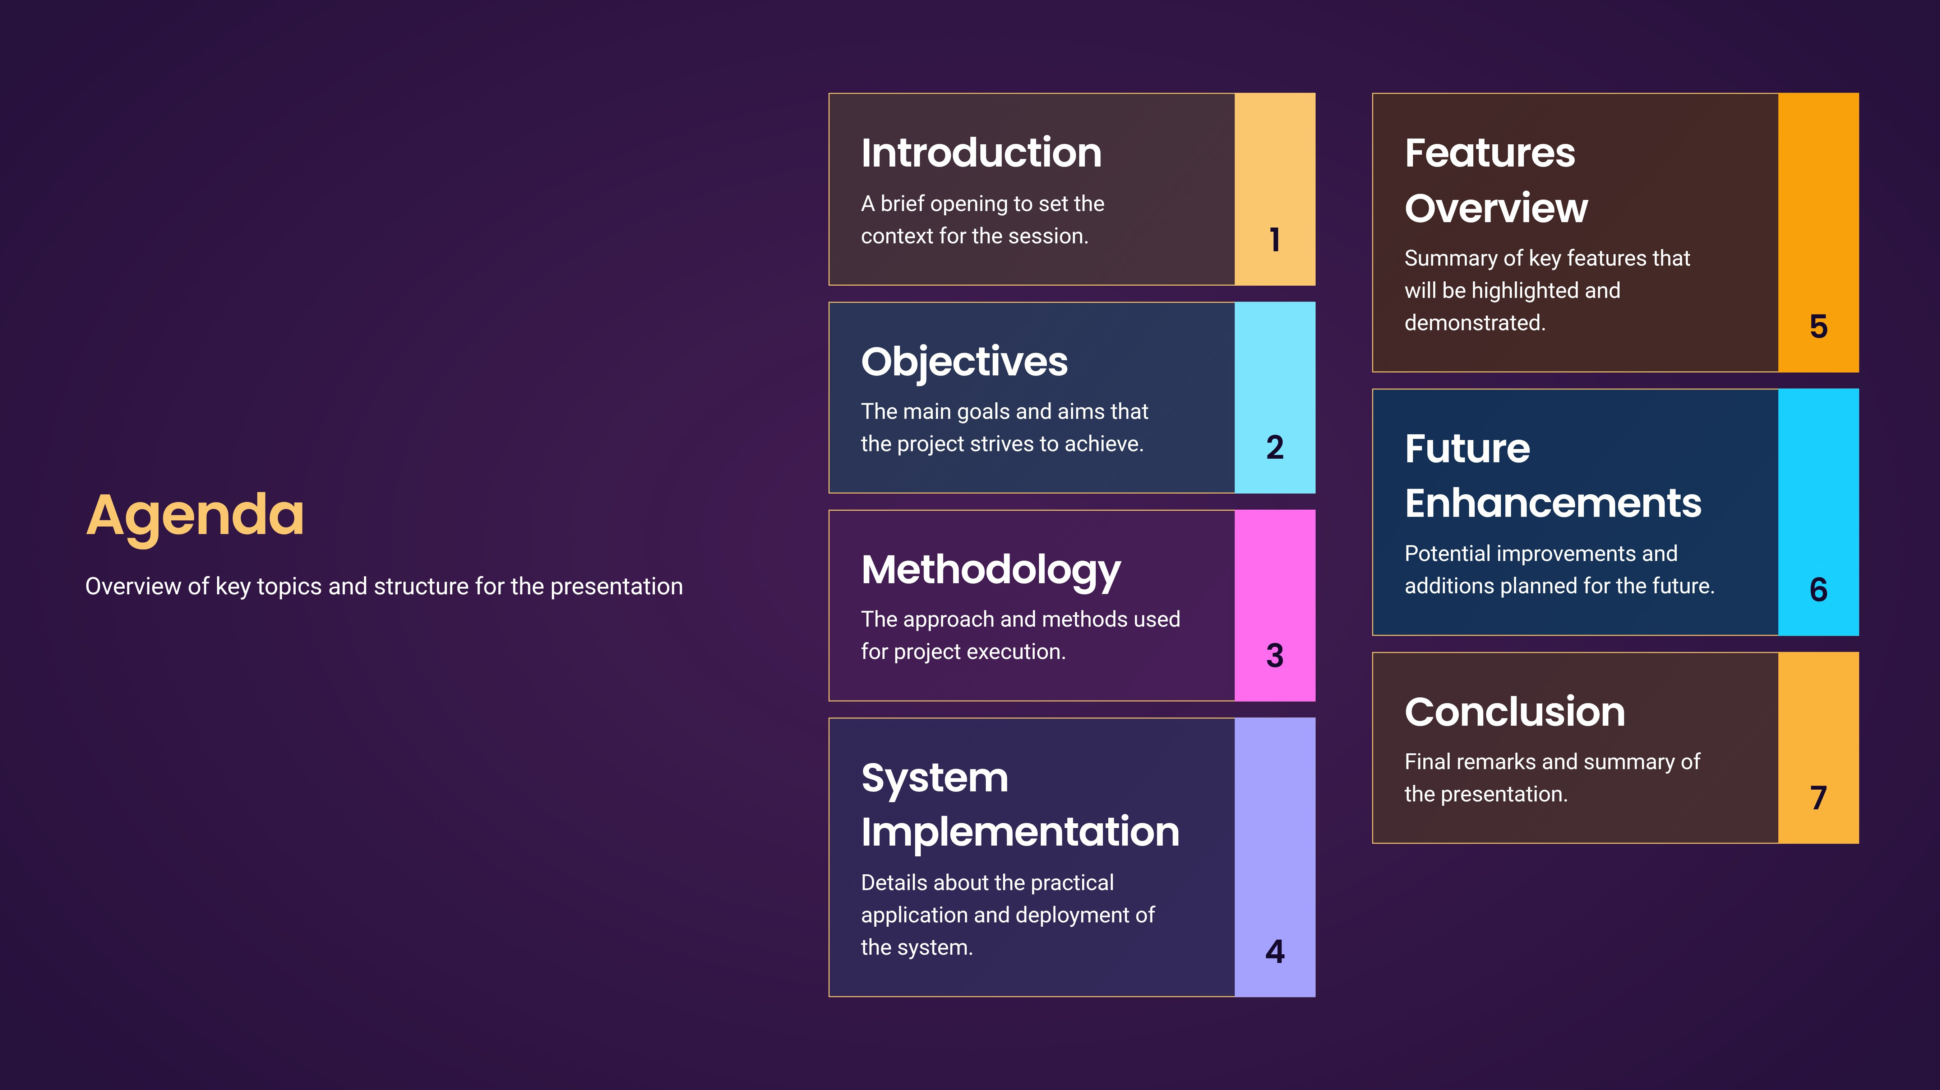
Agenda
Introduction
An overview of the topics to be discussed in the presentation.
CID Objectives
The goals we aim to achieve through this presentation.
Overview
of Presentation Structure
03 Methodology
The approach and methods used for implementation.
04 System Implementation
Details on how the system will be put into action.
CD Features Overview
A summary of the key features available in the system.
Future Enhancements
Potential improvements and features that may be added later.
0 Conclusion
Wrapping up the presentation and highlighting key takeaways.

Slide 3

Introduction to Zentrixon
Web Application for Enhanced Management
Web-based application design
The project is a web-based application designed specitically for Zentrixon Technologies.
Developed with Django
Built using the Django framework, the application ensures efficiency and scalability for various management tasks.
Core functions
Aims to streamline critical functions like job listings, recruitment, payroll, leave, and performance tracking.
Public and private modules
Offers public modules accessible to all, such as Careers and Team pages, as well as private modules via the Employee Portal.

Slide 4


Key Features of Employee Portal
Overview of essential functionalities for job seekers and employees.
•
DynamicJob Seekers Portal
A responsive platform allowing job seekers to explore various roles and learn about the
company culture and values.
•
Secure Employee Login
Implementing a secure login system to facilitate easy access for employees while maintaining data privacy.
Salary & Payslips Access
Employees can conveniently view and manage salary information and payslips through their
account dashboard.
03
Leave Requests Management
04 A streamlined process for employees to submit and track their leave requests, enhancing HR efficiency.
•
Performance Review Tracking
An intuitive interface for employees to view and manage their performance reviews, providing
important feedback.

Slide 5
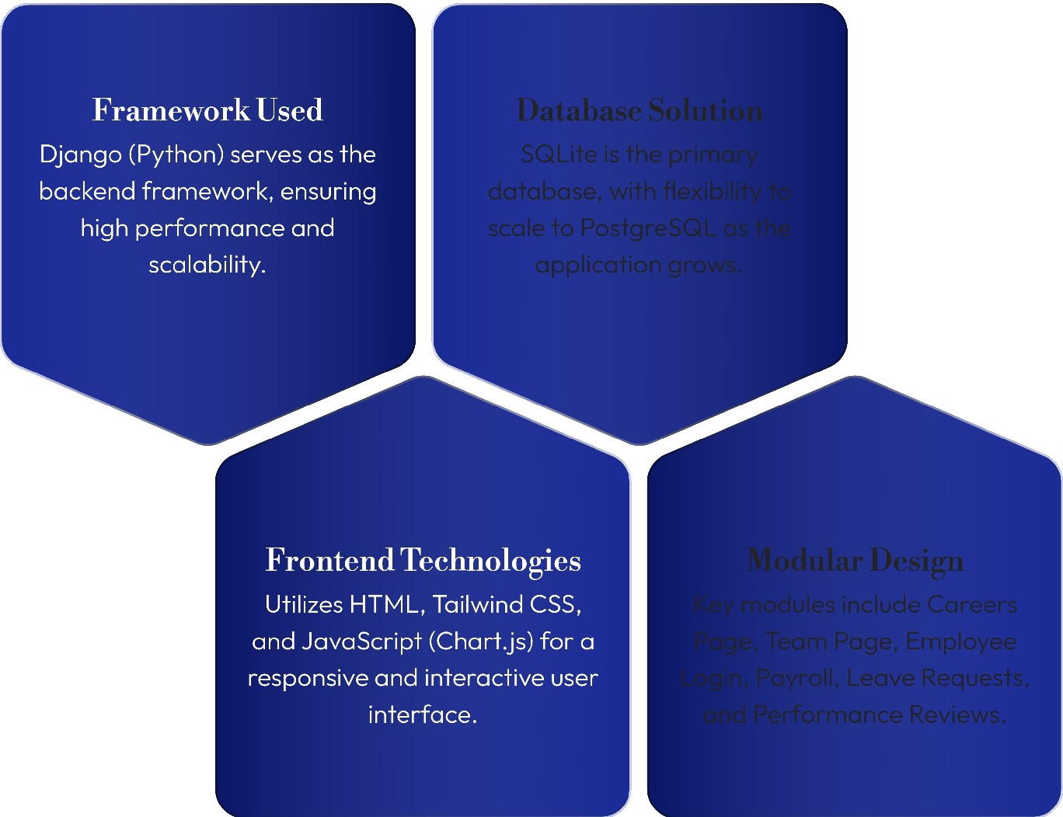
Methodology
Technologies and Framework Overview

Slide 6
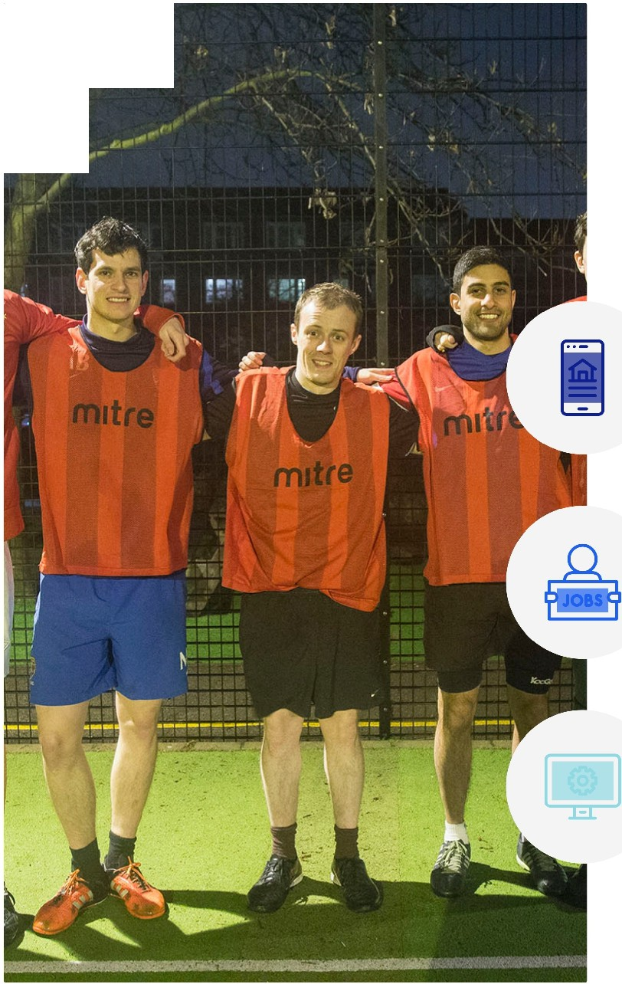
Implementation - Public Site
Key Pages of the Website
Home Page Overview
Introduction to Zentrixon Technologies, showcasing the company's core members details.
Careers Page Features
Dynamic job card layout displaying current job openings like Frontend Developer and Al/ML Engineer.
Team Page Interaction
Interactive team view with cards for a better understanding of team structure across Frontend, Backend, and QA.

Slide 7

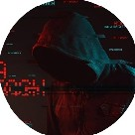
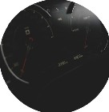


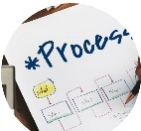
Implementation - Employee Portal
Overview of Key Functionalities
Login & Authentication
Utilising Djongo's built-in system ensures secure user access and identity verification.
Dashboard
The central entry point, providing easy navigation to all internal features and modules.
Payroll Module
Includes detailed monthly salary breakdowns, payslip previews, and downloadable formats.
Leave Management
Employees can apply for, cancel, and track their leave requests seamlessly.
Performance Reviews
Facilitates feedbock and ratings from managers to help in employee assessments.

Slide 8
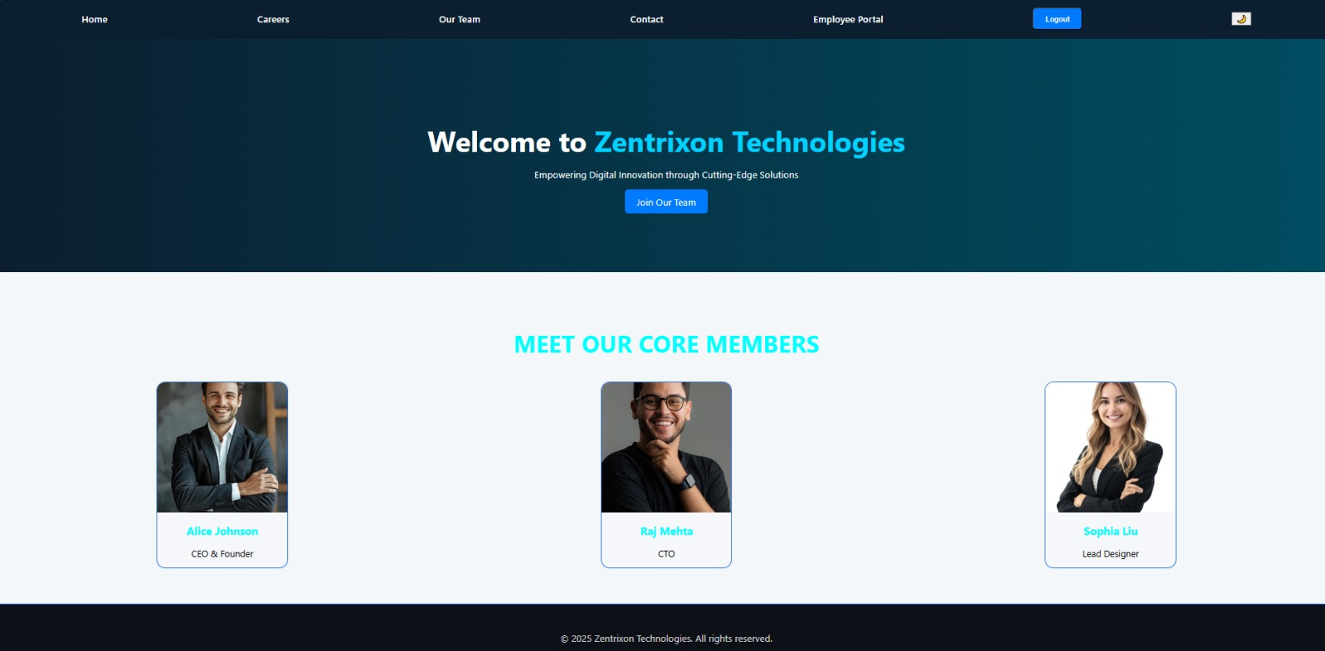
Home Page Snapshot
A visual representation of the home page, this page displays an overview of Zentrixon Technologies with navigation key selections..

Slide 9
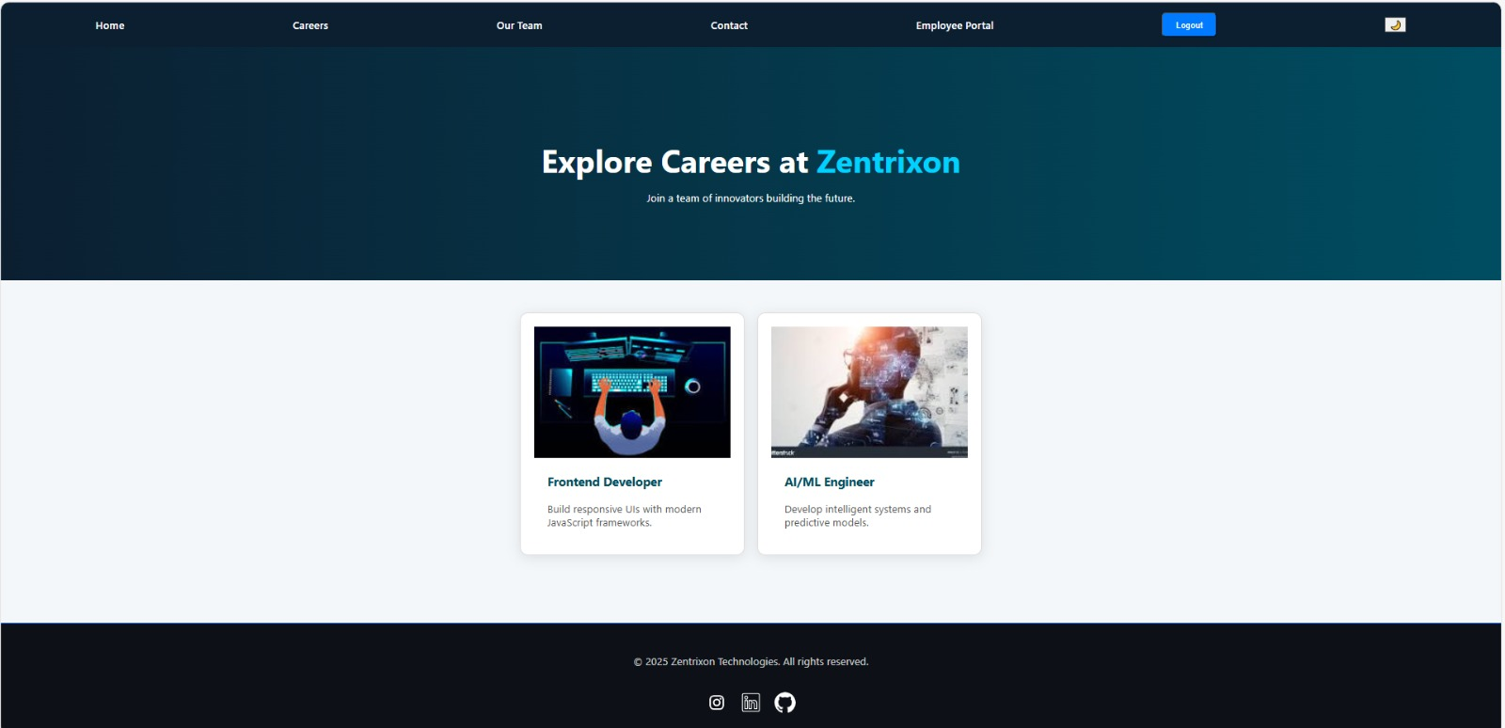
Careers Page Snapshot
A visual representation of the Careers page, this page showcase current job openings with role description and application options.

Slide 10
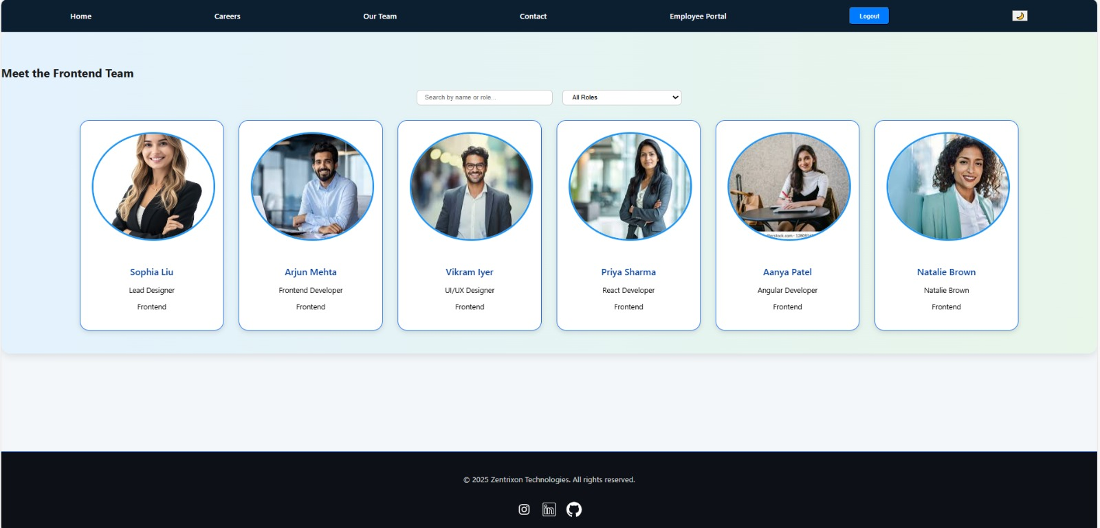
Team Detail Snapshot
A visual representation of the team detail ,this page highlights company team members with names, roles and profile pictures

Slide 11
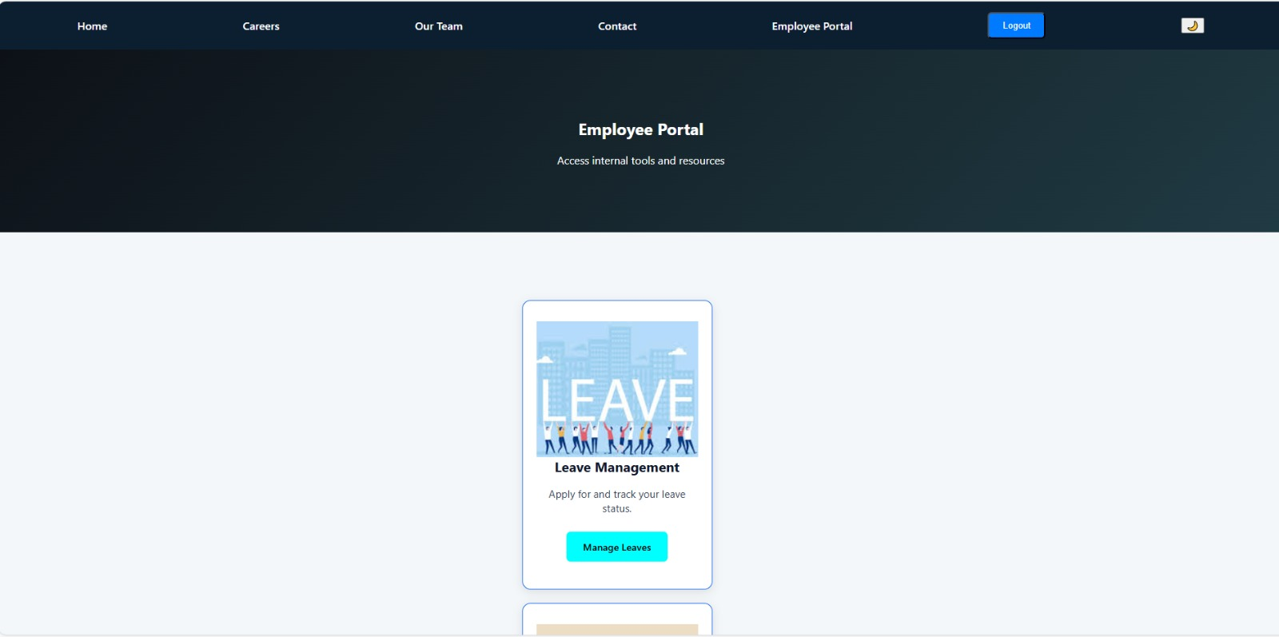
Employee Portal Snapshot
A visual representation of the employee portal, this page provides employees access to payroll,
leave-management and performance reviews.

Slide 12
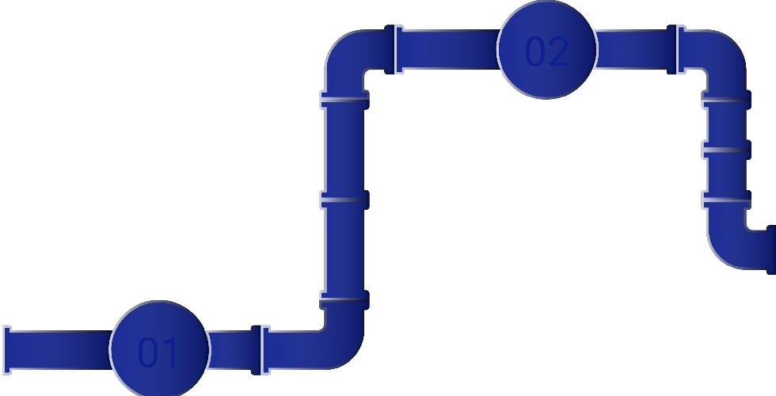
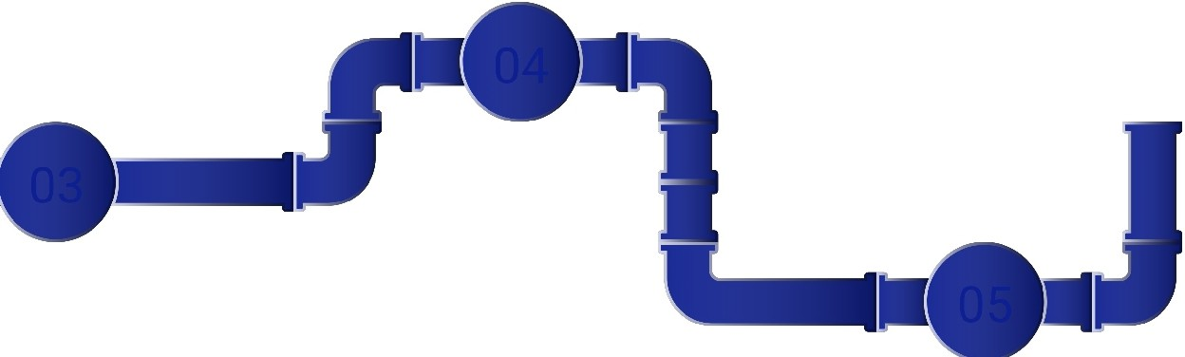
Future Enhancements
Planned Features for Employee Portal
Admin Panel for HR
Email Notifications
Employee Chat Portal
Database Upgrade
Resume Applicant Tracker
Implement an admin panel for HR to streamline job listings, manage leave approvals, and handle payroll more efficiently.
Integrate automated email notifications to update employees on leave requests and payslip statuses for improved communication.
Introduce an employee chat portal or announcement board to enhance internal communication and collaboration among staff.
Transition to PostgreSQL or MySQL to support large-scale deployments, ensuring robust data management and security.
Add functionalities for resume uploads and job application tracking to streamline recruitment and candidate management.

Slide 13
Conclusion
Project Outcomes and Future Directions
•
Successful demonstration of modular Django
development.
The project effectively showcases the capabilities and flexibility of modular Django in building scalable
applications.
•
Combination of public and private features.
Integrates user-facing functionalities with robust employee management tools for enhanced organizational efficiency.
Deployment ready for real organizations.
The portal is primed for implementation in actual business settings with only minor adjustments necessary.
03
Enhances efficiency, transparency, and user experience.
The portal is designed to improve operational performance and user satisfaction for both employees and HR departments.
04

Slide 14
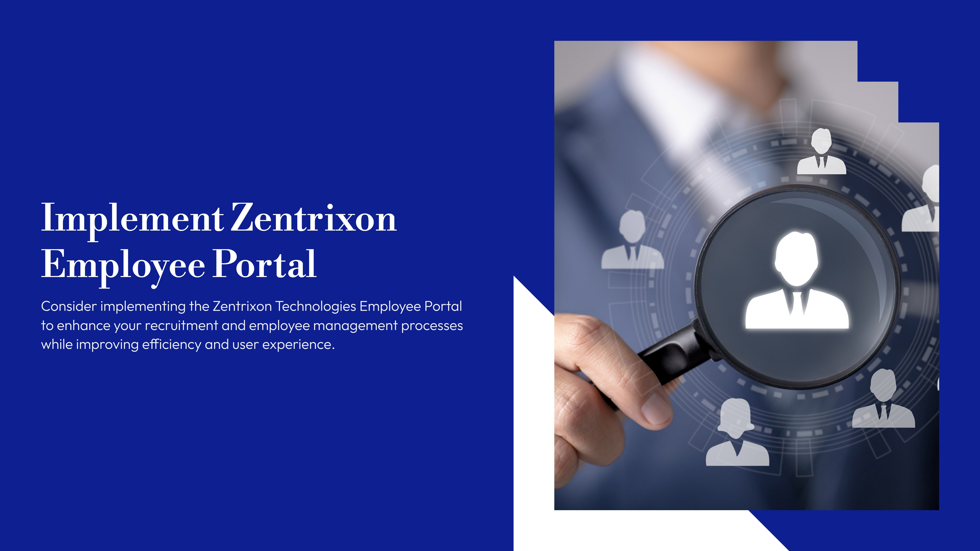
Thank you

